Slide 1
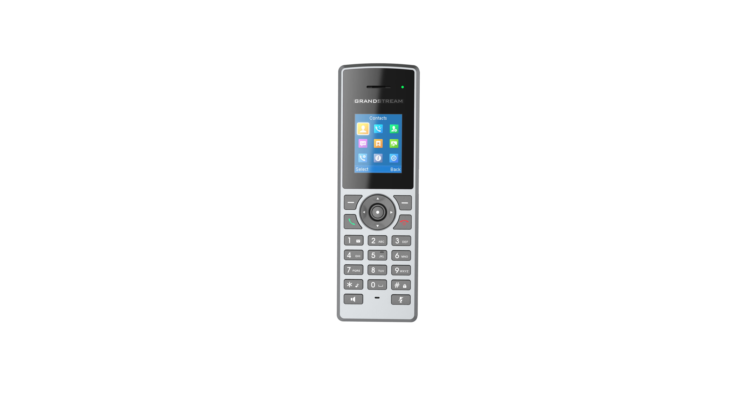
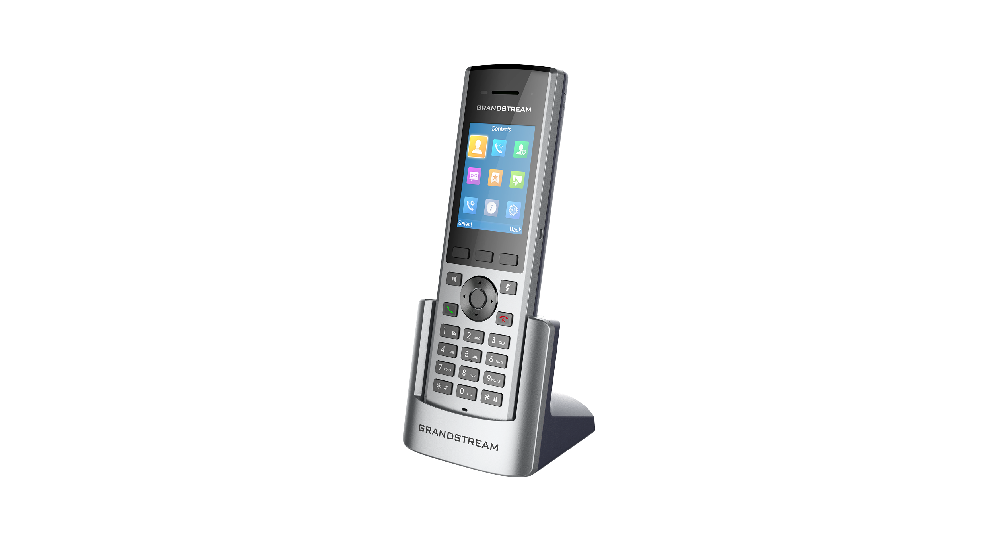
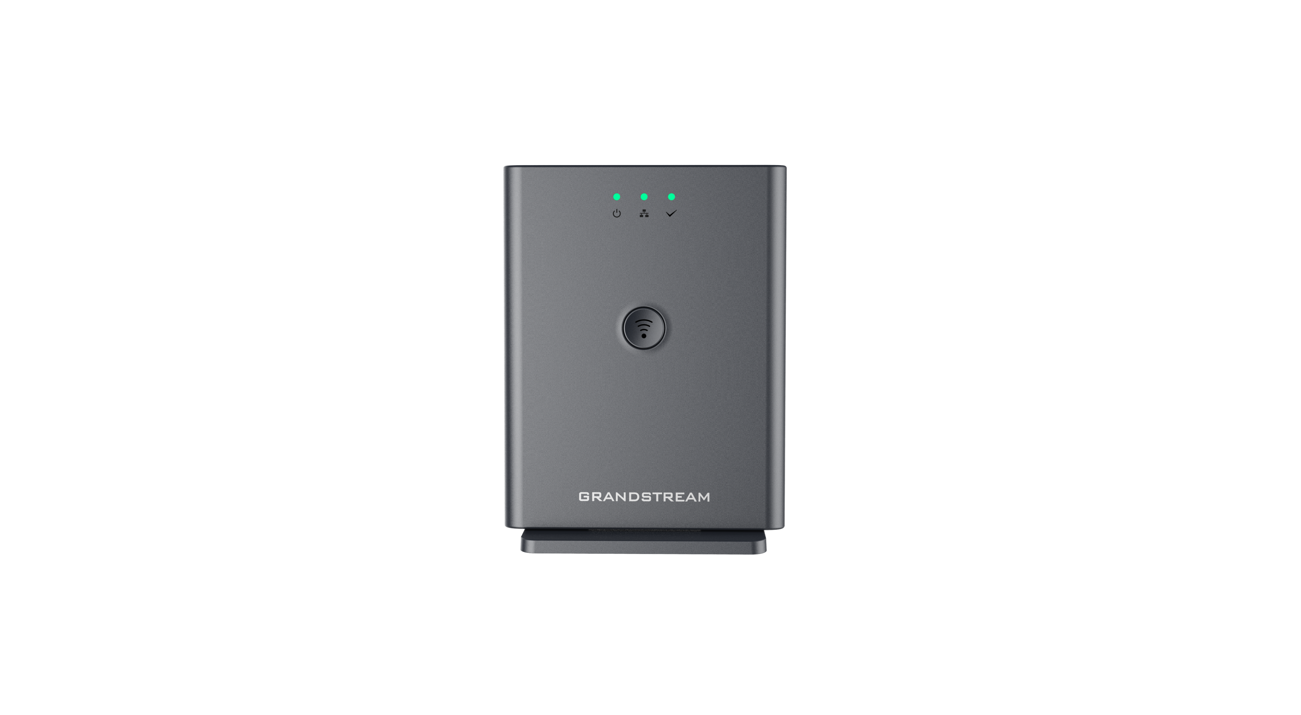
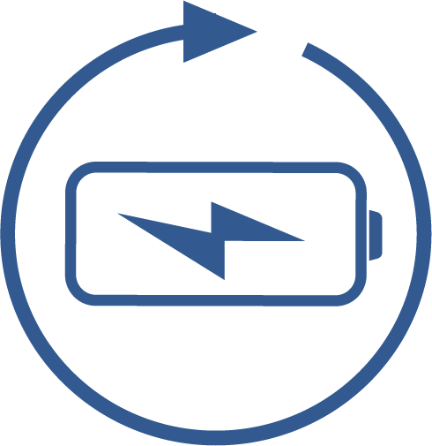
DP722/730/752 DECT Wireless
In environments where roaming free while making and receiving calls is a necessity, the DP722/730 is the go-to-choice. Up to five DP722/730 handsets are supported on each DP752 base station while each DP722/730 supports a range of up to 350/400 meters outdoors and 50 meters indoors from the base station. When paired with Grandstream’s DECT Base Stations, the DP722/730 offers a powerful cordless DECT solution for any business or residential user.
 | DP730 | Yealink W56P | DP722 | Yealink W52P
Battery Capacity | 1500mAh, 3.7V Li-ion | 1460mAh, 3.7V Li-ion | 800mAh, 1.2V Ni-MH AAA x2 | 800mAh, 1.2V Ni-MH AAA x2
Battery Life | 40h+ Talk 500h Standby | 30h Talk 400h Standby | 20h Talk 250h Standby | 5-10h Talk 100h Standby
PSU (Cradle) | Micro-USB port | Fixed USB cable | Micro-USB port | Mini-USB port
Charging (Handset) | Micro-USB port or Cradle | Cradle Only | Micro-USB port or Cradle | Cradle Only
Outdoor Range | 400m (with DP752 base station) | 300m | 350m (with DP752 base station) | 300m
LCD | 2.4” 240x320 color | 2.4” 240x320 color | 1.8” 128x160 color | 1.8” 128x160 color
LCD Backlight | Adjustable | Fixed | Adjustable | Fixed
Headset Jack | 3.5mm | 3.5mm | 3.5mm | 2.5mm
Programmable Softkeys | 3 | 2 | 2 | 2
Dedicated Side Buttons | Volume, Push-To-Talk | N/A | N/A | N/A
Sensors | Accelerometer & Gesture Control | N/A | N/A | N/A
Push-To-Talk | Supported (side or softkey) | Not Supported | Supported by softkey | Not Supported
Custom Ringtones | Supported | Not Supported | Supported | Not Supported
Ring Group Modes | DID, Circular, Linear, Parallel | N/A | DID, Circular, Linear, Parallel | N/A
Repeater Management | Via Web UI | No | Via Web UI | No
Vibration | Supported | Not Supported | Not Supported | Not Supported
Base Station | DP752 and DP750, 10 SIP accounts/lines per system, up to 5 handsets, pair/page button | Same base for W52P & W56P, 5 SIP accounts per system, up to 5 handsets | DP752 and DP750, 10 SIP accounts/lines per system, up to 5 handsets, pair/page button | Same base for W52P & W56P, 5 SIP accounts per system, up to 5 handsets
Competitive Features
10 lines, 10 SIP accounts
DECT authentication & encryption technology
3-way audio conferencing
Rechargeable battery
Speaker-phone with HD acoustic chamber and echo cancellation
Configurable push-to-talk button
HD audio; Full duplex speakerphone
HD Audio
10 Lines
10 SIP Accounts
Configurable push-to-talk
20/40 Hour Talk Time

